Slide 1
Fault Tolerance in Distributed Systems

Slide 2
Topics to be covered based on these questions
What is a fault, an error and a failure?
What is fault tolerance? How systems are made dependable?
What are dependability requirements?
Specify various types of faults
How to develop a fault tolerant system?
Masking failures?
How to protect processes from failures?
Agreement in faulty system – Byzantine Agreement

Slide 3
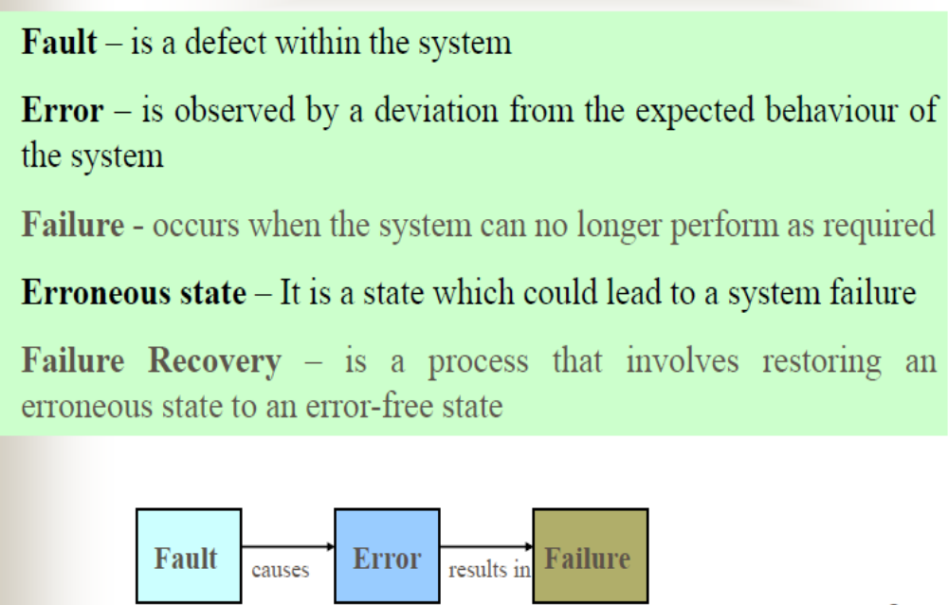
Basic Concepts
Notes:
Fault – machine fault, hardware fault
he cause of the failure. Error: The mistake which caused the fault to occur

Slide 4
Fault tolerance - Dependability
Availability – ready most of the time
Reliability – running continuously without failure
Safety – temporarily fails but no catastrophic happens
Maintainability – how easily a system can be repaired
Notes:
When we say system is dependable when it is available, reliable, safe and maintainable. The system is fault tolerant if these things are achieved.

Slide 5
Types of faults
Transient
- occur once and disappears
eg: transmitter cause loss of bits
Intermittent
- occurs, vanishes and then reappears and so on
e.g: loose contact on a connector
Permanent
- continues to exist till faulty component is replaced e.g: burnt out chips, s/w bugs

Slide 6
Requirement Specification
Failure types:
  Some are more probable than others
  Some are transient, others permanent
  Some occur in hardware, others in software

Slide 7
Design
Fault Tolerant system: Hides the occurrence of failure from other processes
Design of systems that tolerate faults that occur while system is in use
Masking faults : Basic Principle – Redundancy
  Spatial/Physical - redundant hardware/processes
  Informational - redundant data structures – Hamming code
  Temporal/Timing - redundant computation - transactions
Notes:
Hamming codes are a type of error-correcting code used in digital communication and data storage systems to detect and correct errors that may occur during transmission or storage. They are named after Richard Hamming, who introduced them in the 1940s.

Slide 8
Redundancy costs money and time
  Optimize the design by trading off amount of redundancy used against the desired level of fault tolerance
  Temporal redundancy usually requires re-computation and it results in a slower recovery from failure
  Spatial has faster recovery but increases hardware costs, space, power etc. requirements

Slide 9
Commonly Used Techniques for Redundancy
  Modular redundancy
    Uses multiple, identical replicas of hardware modules and a voter mechanism
    The outputs from the replicas are compared, and correct output is determined - majority vote
    Can tolerate most hardware faults that can affect the minority of the hardware modules

Slide 10
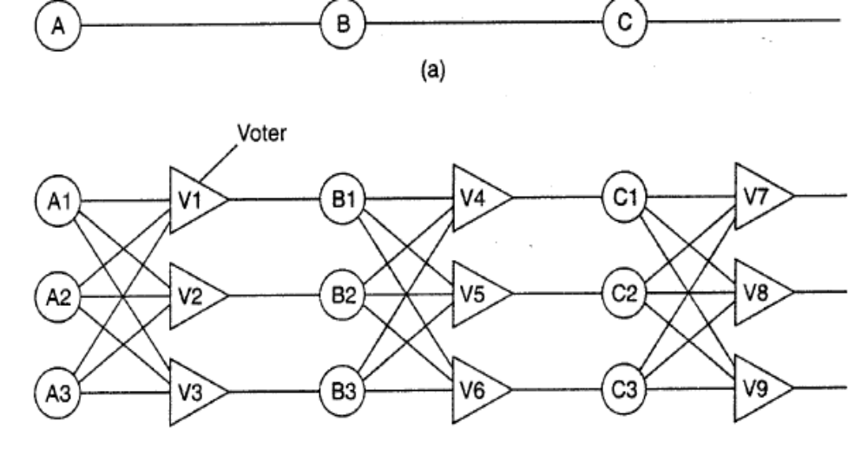
Triple Modular Redundancy
Notes:
Triplication: The critical component or subsystem is replicated three times, creating three identical modules. These modules operate in parallel and are synchronized to process the same input data simultaneously.
Voting Logic: After processing the input data, a voting mechanism compares the outputs of the three modules. The most common voting logic used in TMR is a majority-voting scheme, where the output chosen is the one that appears at least twice among the three modules' outputs. This ensures that even if one of the modules produces an incorrect output due to a fault, the correct output can still be determined based on the majority.

Slide 11
N- Version Programming
  Write multiple versions of a software module
  Outputs from these versions are received and correct output is determined via voting mechanism
  Each version is written by different team, with the hope that they will not contain the same bugs
  Can tolerate software bugs that affect a minority of versions
  Cannot tolerate correlated fault - reason for failure is common to two (or more) modules eg two modules share a single power supply, failure of which causes both to fail
Notes:
N-Version Programming (NVP) is a software fault tolerance technique that aims to improve the reliability of software systems by independently developing multiple versions (or implementations) of the same functionality and running them concurrently in a distributed or replicated environment. The idea behind N-Version Programming is that different versions of the software may have different faults or bugs due to diverse design, coding, or testing techniques. By combining the outputs of multiple versions and comparing them, NVP can identify and mitigate the effects of faults or errors, thus improving overall system reliability.

Slide 12
Classification of failures
Process failures
deadlocks, timeouts, wrong input by the user
System failures
process fails to execute
caused by s/w errors and h/w problems

Slide 13
Failure models
Omission Failure
  A server omits to respond to a request or receive request
Response Failure
  Value failure - returns wrong value
  State transition failure - has wrong effect on resources
Timing Failure- any response that is not available to a client within a specified real time interval
Server Crash Failure: a server repeatedly fails to respond to requests until it is restarted
  Amnesia- crash - a server starts in its initial state, having forgotten its state at the time of the crash, ie loses the values of the data items
  Pause- crash - a server restarts in the state before the crash
  Halting- crash - server never restarts
Arbitrary failure: A server may produce arbitrary responses at arbitrary times.

Slide 14
Handling Failures

Slide 15
Process Resilience
Processes can be made fault tolerant by arranging to have a group of processes, with each member of the group being identical .
A message sent to the group is delivered to all of the “copies” of the process (the group members), and then only one of them performs the required service.
If one of the processes fail, it is assumed that one of the others will still be able to function (and service any pending request or operation
Notes:
Through process resilience by grouping them instead of multiple processes acts at a time.

Slide 16
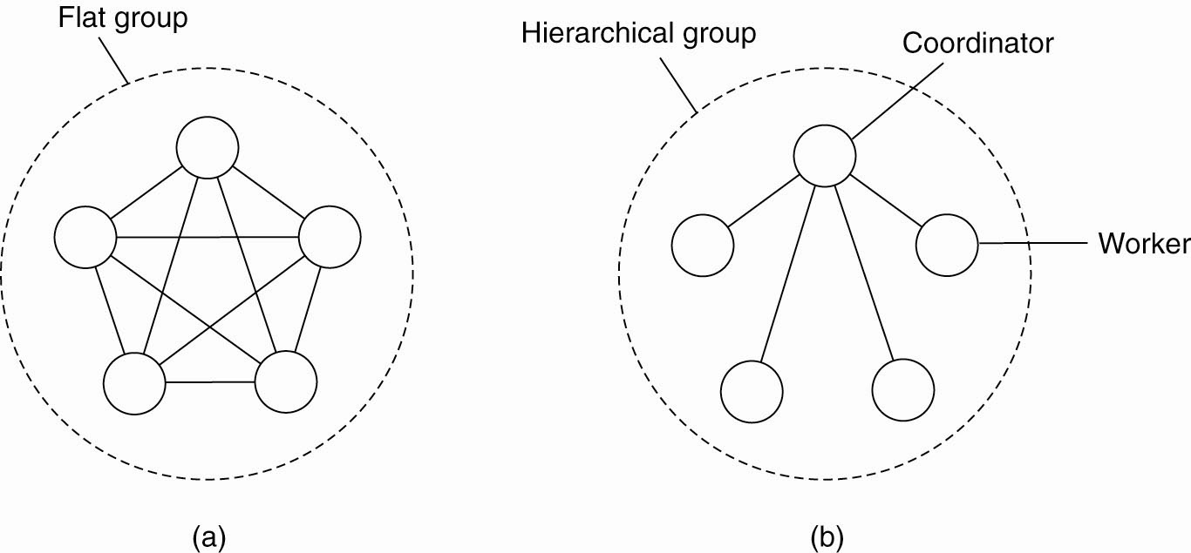
Flat Groups versus Hierarchical Groups
Figure 8-3. (a) Communication in a flat group.
(b) Communication in a simple hierarchical group.

Slide 17
Communication in a flat group – all the processes are equal, decisions are made collectively.
  Note: no single point-of-failure, however: decision making is complicated as consensus is required.
Communication in a simple hierarchical group - one of the processes is elected to be the coordinator, which selects another process (a worker) to perform the operation.
  Note: single point-of failure, however: decisions are easily and quickly made by the coordinator without first having to get consensus.

Slide 18
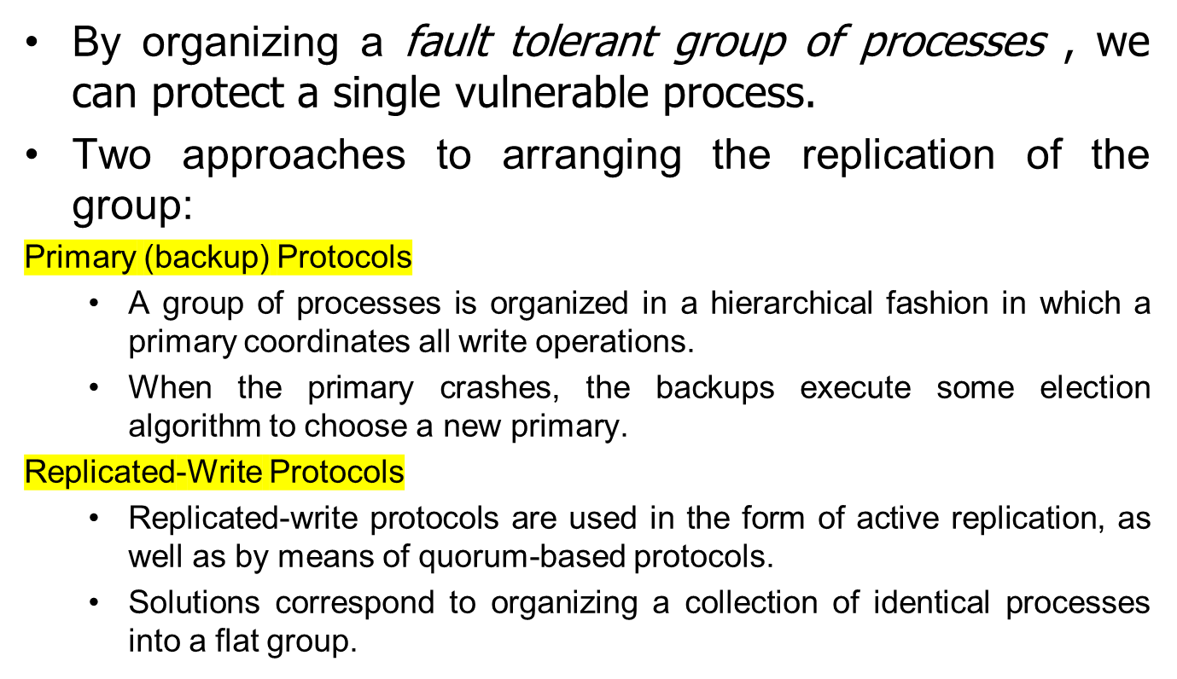
Failure Masking and Replication

Slide 19
Agreement in Faulty Systems
Goal of distributed agreement algorithms to have all the non-faulty processes reach agreement on some issue, and to establish that agreement within a finite number of steps.
Notes:
A faulty system refers to a system that does not perform as expected or intended due to the presence of faults, errors, or defects. Faults in a system can arise from various sources, including hardware failures, software bugs, design flaws, human errors, environmental factors, and unexpected interactions between system components.

Slide 20
Agreement issue in Faulty Systems
Possible assuptions about the underlying system:
Synchronous versus asynchronous systems.
Communication delay is bounded or not.
Message delivery is ordered or not.
Message transmission is done through unicasting or multicasting.
Notes:
Delay is bounded if and only if we know that every message is delivered with a globally and predetermined maximum time.

Slide 21
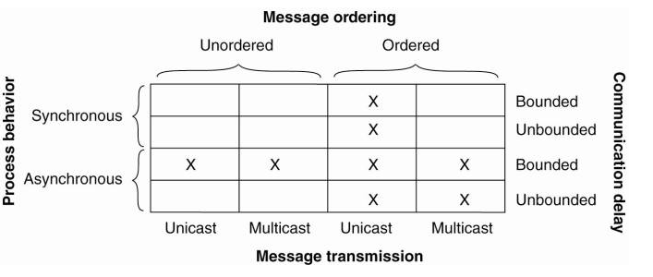
Circumstances under which distributed agreement can be reached

Slide 22
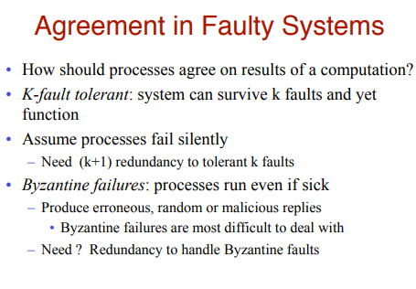


Slide 23
Problems of Agreement
A set of processes need to agree on a value (decision), after one or more processes have proposed what that value (decision) should be
Examples:
  mutual exclusion, election, transactions
Processes may be correct, crashed, or they may exhibit arbitrary (Byzantine) failures
Messages are exchanged on an one-to-one basis, and they are not signed

Slide 24
Consensus and related problems
System model
  N processes {p₁, p₂, ..., p_{N}}
  Communication is reliable but processes may fail
  At most f processes out of N may be faulty.
    Crash failure
    Byzantine failure (arbitrary)
  The system is logically fully connected
  A receiver process knows the identity of the sender process
  Limiting faults solely to the processes simplifies the solution to the agreement problems

Slide 25
Authenticated & Non-authenticated messages
To reach an agreement, processes have to exchange their values and relay the received values to other procs
  Authenticated or signed message system – A (faulty) process cannot forge a message or change the contents of a received message (before it relays the message to other).
    A process can verify the authenticity of a received message
  Non-authenticated or unsigned or oral message – A (faulty) process can forge a message and claimed to have received it from another process or change the contents of a received message before it relays the message to other.
    A process has no way of verifying the authenticity of a received message

Slide 26
Two Agreement Problems
Consensus problem:
  N processes agree on a value (e.g. synchronized action – go / abort)
  Consensus may have to be reached in the presence of failure
    Process failure – crash/fail-stop, arbitrary failure
    Communication failure
  All process i starts in an “undecided” state
  Every process i proposes a value v_{i} , from a set D while in the undecided state.
  Process i exchanges messages until it makes decision d_{i} and moves to decided state.
  A consensus is reached if all correct processes agree on the same value d_{i}

Slide 27
Byzantine Agreement Problem: Lamport et al. 1982
Assume reliable synchronous ordered unicast based message system. There are N process, k of which may act as faulty or even malicious. A faulty process may send different values to different processes.
Notes:
A Byzantine fault is defined as an arbitrary fault that occurs during the execution of an algorithm by a distributed system. When a Byzantine failure occurs, the system may respond in any arbitrary way unless it is designed to have Byzantine fault tolerance.

Slide 28
Byzantine failure
In fault-tolerant distributed computing, a Byzantine failure is an arbitrary fault that occurs during the execution of an algorithm in a distributed system. When a Byzantine failure has occurred, the system may respond in any unpredictable way.
These arbitrary failures may be loosely categorized as follows:
  a failure to take another step in the algorithm, also known as a crash failure;
  a failure to correctly execute a step of the algorithm; and
  arbitrary execution of a step other than the one indicated by the algorithm.

Slide 29
Byzantine failure
Byzantine refers to the Byzantine Generals' Problem, an agreement problem in which generals of the Byzantine Empire's army must decide unanimously whether or not to attack some enemy army.
The problem is complicated by the geographic separation of the generals, who must communicate by sending messengers to each other, and by the presence of traitors amongst the generals.
These traitors can act arbitrarily in order to force good generals into a wrong decision: trick some generals into attacking; force a decision that is not consistent with the generals' desires,
  e.g. forcing an attack when no general wished to attack; or so confusing some generals that they never make up their minds. If the traitors succeed in any of these goals, any resulting attack is doomed, as only a concerted effort can result in victory.
  Lamport et al., proved that with number of bad generals 1/3 or less, there is a solution.

Slide 30
The Byzantine Generals Problem: Distributed Consensus
Let us assume we have five generals…
Notes:
We are less interested in computing a specific value but are more interested in all the loyal generals holding the same value or making the same decision!

Slide 31
The Byzantine Generals
Let us assume one is malicious…
Notes:
Malicious : Byzantine fault – node alive and intentionally confusing other nodes by providing conflicting data

Slide 32

The Byzantine Generals
Each local general decides on an attack plan…
0
1
4
3
2
Notes:
Each general decides independently …

Slide 33
The Byzantine Generals
… and accurately relays their plan …

Slide 34
The Byzantine Generals
…except the random malicious one…
Notes:
Naïve solution does not work:
Traitors may send different values to different generals.
Loyal generals might get conflicting values from traitors

Slide 35
The Byzantine Generals
Each general collects his or her votes…
0
1
4
3
2
Notes:
Generals numbered in sequence: clockwise with top center numbered 0 to decode the array of votes …
----------
Every General being truthful and independent should usually ensure that the majority vote works to break the tie …
Unless we have malicious/compromised General who sends mixed signals …
No sayer sees an extra Yes, and Yes sayer sees an extra No …
---------
As we will see shortly, all loyal generals DO NOT see the same inputs, so the majority vote actually leads them astray!!!
VIOLATION OF ASSUMPTION FOR THE MAJORITY TO WORK – Byzantine fault…

Slide 36
The Byzantine Generals
Assume each general takes the majority vote…
Notes:
Generals that voted not to attack are the ones moved to attack,
while the Generals who voted to not attack are the ones that are stopped from attacking.

Slide 37
The Byzantine Generals
The generals now move based upon their ‘agreed’ orders…

Slide 38

The Byzantine Generals
Since less than half of the military attacked, the military attack failed…
0
1
4
2
3
Notes:
Consensus through majority did not work because different votes were shown to different participants by the malicious voter

Slide 39
The Byzantine Generals
What’s more troubling is that:
the remaining loyal nodes do not know which node(s) among them are disloyal.
 | #0 | #1 | #2 | #3 | #4
#1
#3
#4
Notes:
The two pink loyal nodes (#0, #2) which are gone and the pink malicious node (#4) all look alike to (#1, #3).
Recall #1, #3 decided not to attack because of their collective pink majority vote.
In contrast, #0, #2 registered the following votes: “pink-green-pink-green-green”

Slide 40
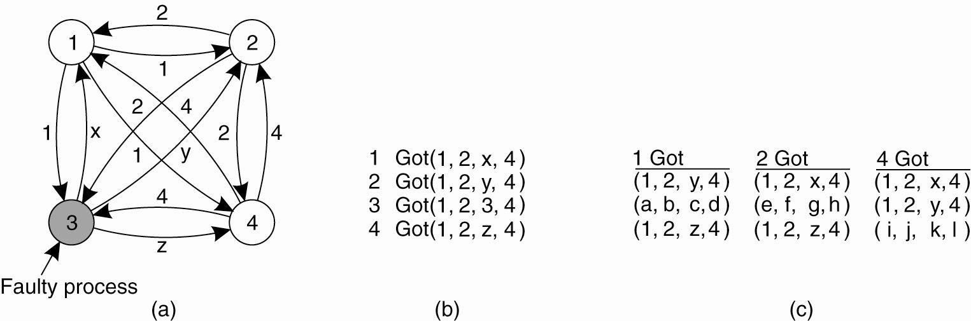
Example: Byzantine Agreement problem for four processes
Three non-faulty and one faulty process. (a) Each process sends their value to the others. Process 3 lies, giving different values x, y,z to different processes.

Slide 41
Byzantine Agreement problem-2
(b) The vectors that each process assembles based on (a).
(c) The vectors that each process receives in step 3. Process 3 sends different vectors to different processes.

Slide 42
Byzantine Agreement problem-3
Three processes can agree on the values received from 1, 2, and 4. So that malicious process 3 value is irrelevant…
If N=3 and k=1, that is only two non-faulty process this will not work!
Lamport proved that, with 2k+1 nonfaulty processes, the system will survive k faulty processes, which makes a total of 3k+1 process…

Slide 43
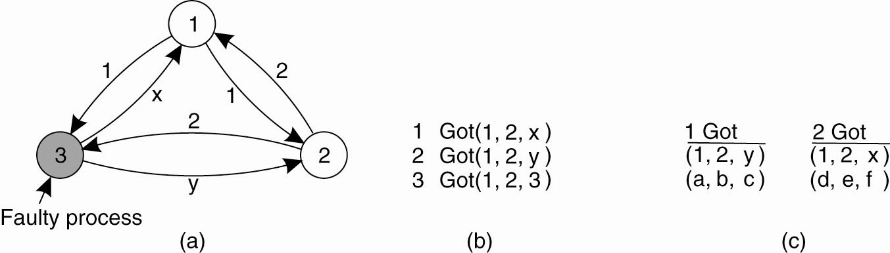
BAP with two correct on faulty processes..
Figure 8-6. The same as Fig. 8-5, except now with two correct process and one faulty process.

Slide 44
Client Server Communication
TCP-Transport Control Protocol as a connection oriented end-to-end communication protocol is a reliable protocol.
But it does not prevent connection crash failures, which require searching for new connections…

Slide 45
RPC Semantics in the
Presence of Failures
Five different classes of failures that can occur in RPC systems:
    The client is unable to locate the server.
    The request message from the client to the server is lost.
    The server crashes after receiving a request. This can be handled with principles such as:-
      At least once
      At most once
      The preferred principle is exactly once – not possible
    The reply message from the server to the client is lost.
    The client crashes after sending a request.
Each case needs to be resolved properly to mask the failures

Slide 46
Failure Examples
UDP service
-has omission failures because it occasionally looses messages
does not have value failures because it does not transmit corrupt messages.
  UDP uses checksums to mask the value failures of the underlying IP by converting them to omission failures

Slide 47
Reliable Multicasting
Use negative acknowledgement, known as scalable reliable multicasting-SRM
Non-hierarchical and hierarchical solutions are possible
Atomic multicasting requires all the replicas reaching agreement on the success or failure of multicast. This is known as distributed commit: two-phase or three-phase commit protocols can be used.

Slide 48
Recovery from a failure
When and how the state of a distributed system be recorded and recovered to by means of check-pointing and logging.
To be able to recover to a stable state, it is important that the state is safely stored..

Slide 49
Stable Storage
Stable storage is an example of group masking at the disk block level
Designed to ensure permanent data is recoverable after a system failure during a disk write operation or after a disk block has been damaged

